Slide 1
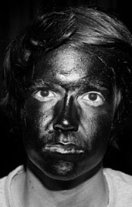
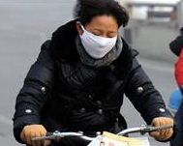
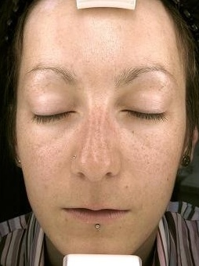
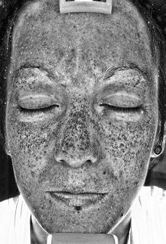
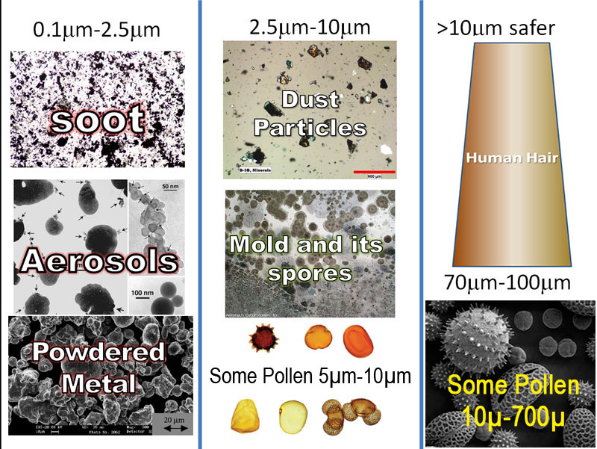
Lab 6: Ultraviolet Light and Air Pollution

Slide 2
Protection from Ultraviolet Light

Slide 3
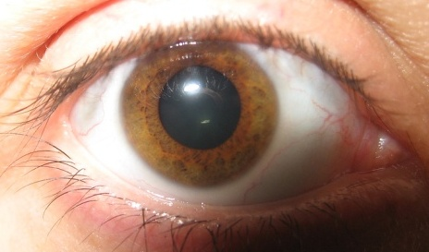
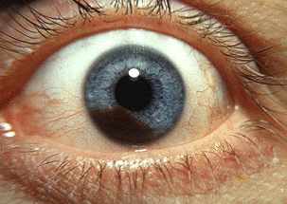
UV light contributes to cataracts (cloudiness) in the lens of the eye and to melanoma cancer that can affect the whole eye.
Cataracts
Melanoma

Slide 4
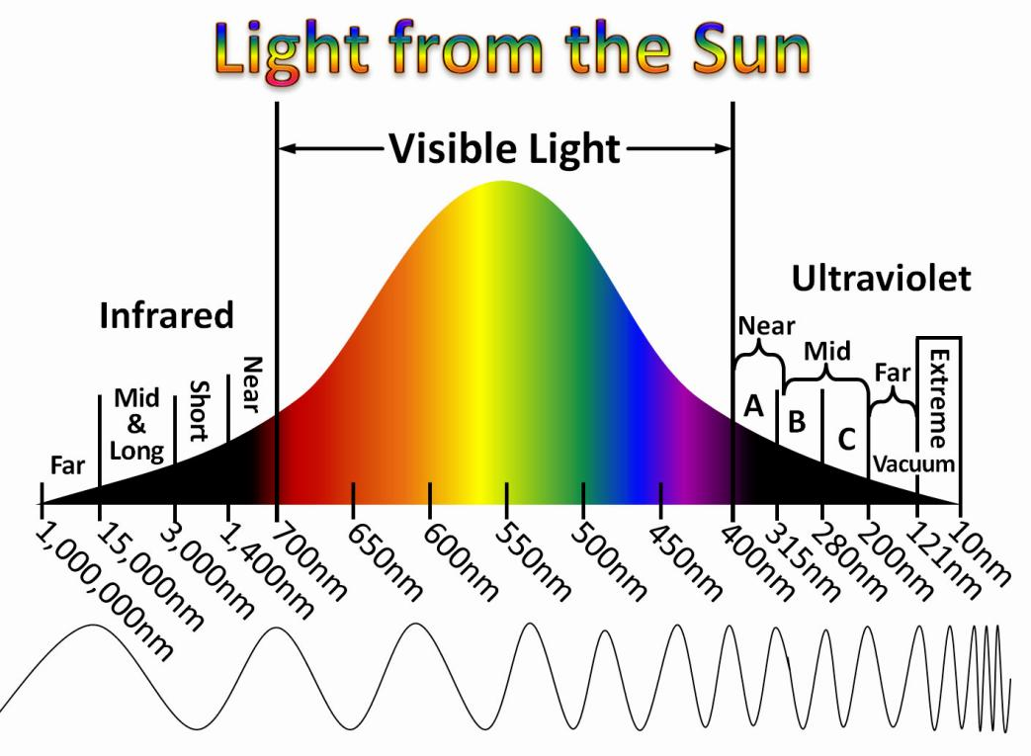
The shorter the wavelength of UV light, the more dangerous it is.
Far (vacuum) UV (less than 200 nm) is the most dangerous.
But because air blocks these wavelengths of UV, we don’t normally worry about it.

Slide 5
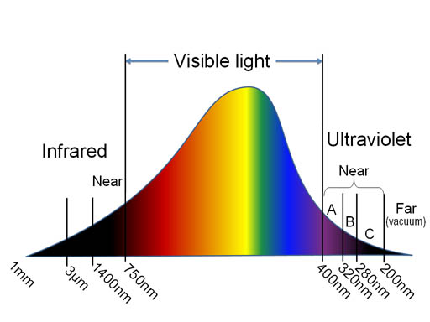
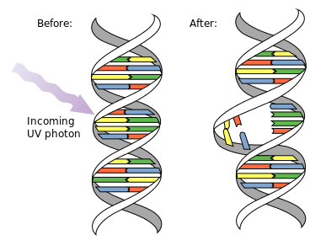
Ultraviolet B (UVB) causes sunburns and some forms of skin cancer. Much of the UVB from the sun gets blocked by ozone in the upper atmosphere; however, some still comes through to do damage to DNA in skin.

Slide 6
Ultraviolet A (UVA) doesn’t cause sunburns but can still damage skin. UVA is not stopped by the atmosphere.

Slide 7
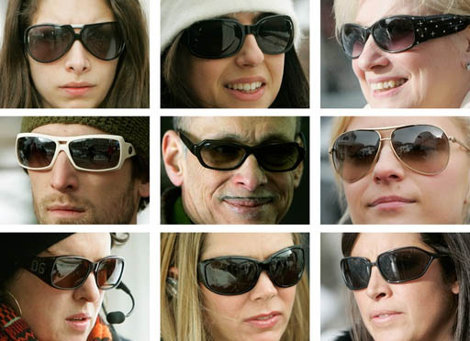
Sunglasses are best defense against UV damage to eyes:
Sunglasses are good for reducing glare but more importantly they reduce the UV light that hit our eyes.

Slide 8
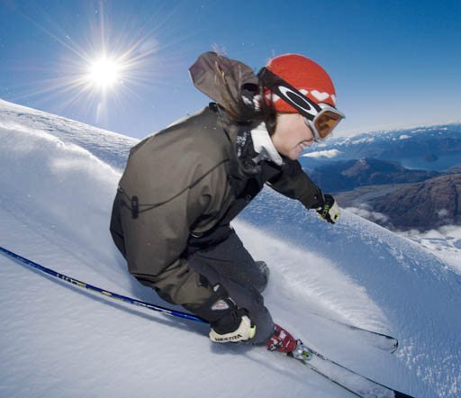
Skiers wear goggles not just to keep snow and cold away from the eyes, but also to protect their eyes from UV light because the snow reflects about 85% of the UV light and the higher elevations have more UV light. This gives the eyes a triple dose of UV light. You've probably heard of "snow blindness." In the past I thought it was from too much
brightness that tired the eyes. In fact it's an over exposure to UV light that clouds the cornea (the clear part over the pupil). This can cause temporary or permanent blindness.

Slide 9
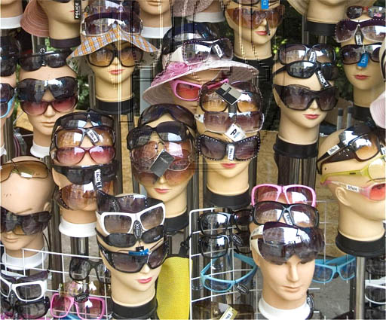
It is recommended that sunglasses block 95% to 99% of UV-A and UV-B light.
There's a wide array of sunglasses and nearly all of them say they block all or most of the UV light; however, how truthful are their claims?

Slide 10
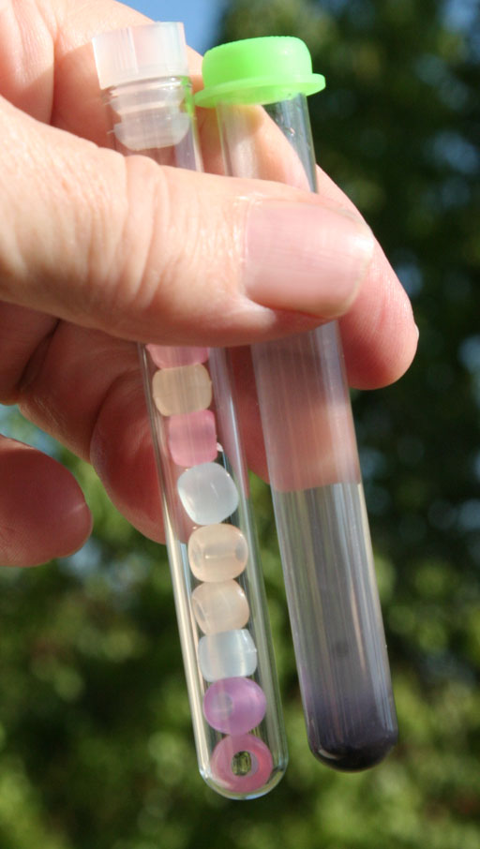
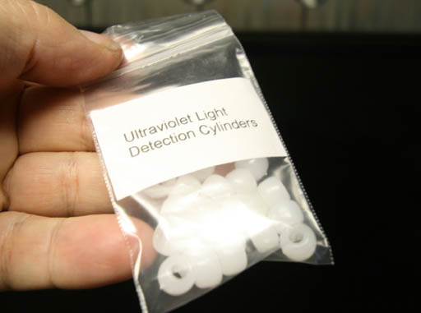
Your lab drawer has a test tube with white beads that react to UV light. Your instructor also has plastic packets of these beads. You can use either one of these to detect UV light.

Slide 11
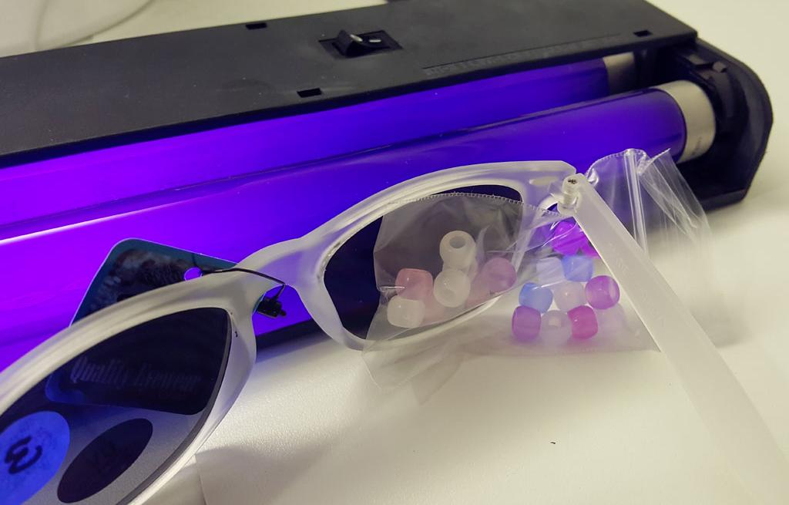
If the sunglasses block all UV light, then the UV detection beads will be white. If some color is seen, compare colors to those with no UV blocked. Here the colored beads seem to have about 25% of the color of the unblocked beads. So the sunglasses are blocking 75% of the UV light.

Slide 12
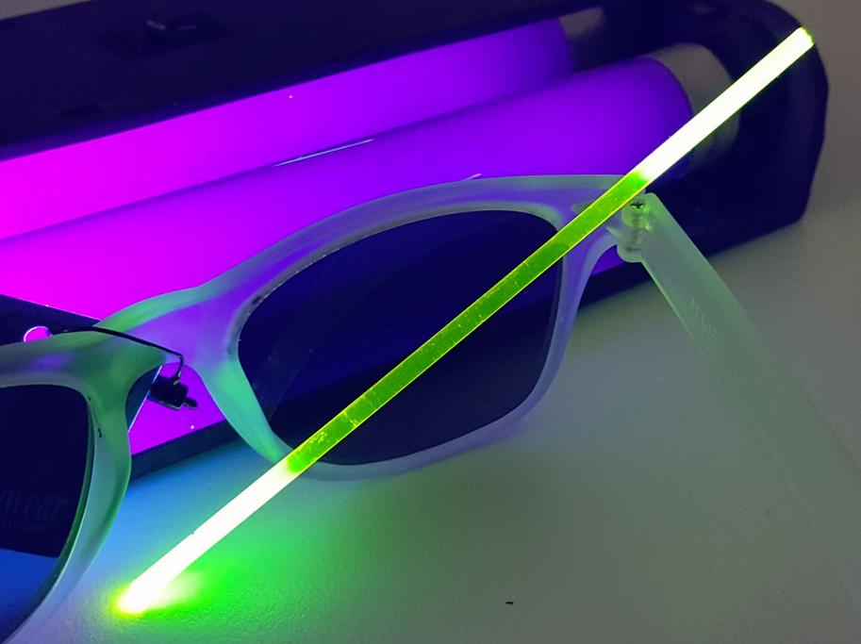
This UV sensitive rod can also be used as an estimate for how much UV light the sunglasses block.

Slide 13
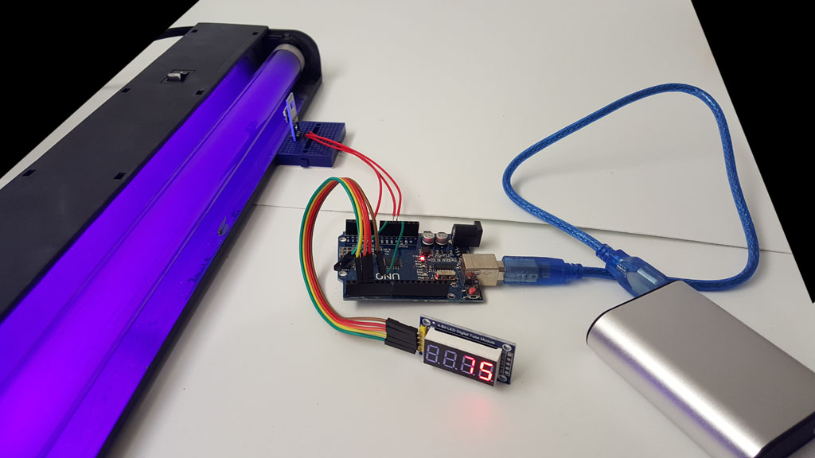
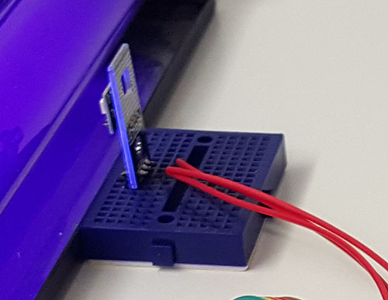
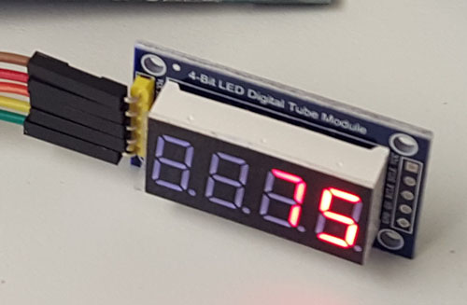
A UV sensor is hooked up to an Arduino brand microprocessor (low power computer). The amount of UV light detected is displayed on an LED digital readout.
5 volt power supply
UV sensor.
LED readout

Slide 14
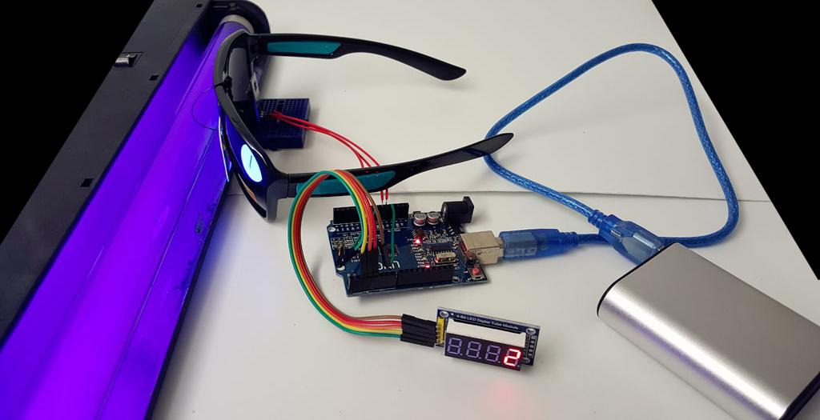
UV sensor is measuring the amount of UV light that gets through the sunglasses. If the readout was 75 before the sunglasses were placed between UV lamp and UV sensor, then the sunglasses blocked 73 out of 75 or 97% (73/75).

Slide 15
Check Sunglasses using UV light sensor hooked to Arduino: First read the UV level that the sensor sees without the sunglasses. Record that here(A): __________ Then place the each of the three sunglasses in front of the sensor and get those levels. That will be how much UV light gets through(B).
UV level Sunglasses #1 ________ UV level Sunglasses #2 ________ UV level Sunglasses #3 ________
Now figure out how you would find out the percentage of UV light that each of those sunglasses blocked.
What gets through + What gets blocked = Full UV level. Subtract What gets through from both sides. What gets blocked = Full UV level(A) – What gets through(B)
(A-B)/A is fraction of full UV level blocked. Multiply by 100 to get fraction as a percent.
Sunglasses #1 blocks: _______ % Sunglasses #2 blocks: _______% Sunglasses #3 blocks: ______ %

Slide 16
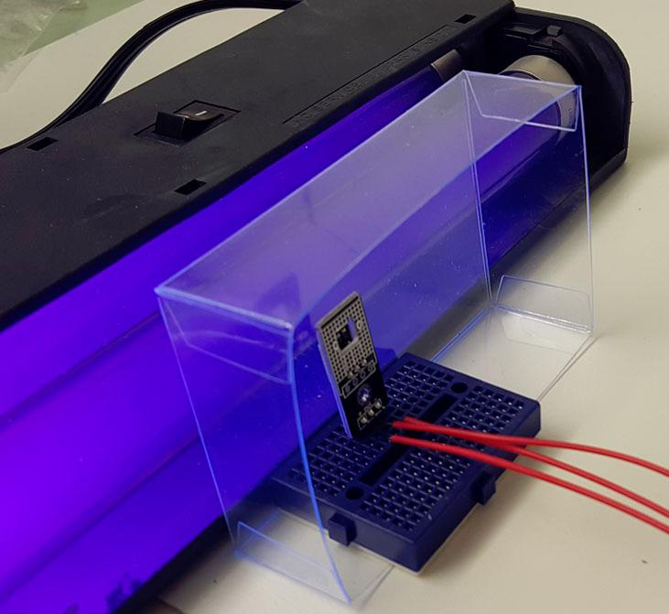
Check sunscreen using UV light sensor hooked to Arduino: You will test different strengths (SPF=Sun Protection Factor). For example, SPF 30 means that 1/30 of the UV light will penetrate the sunscreen. Traditional sunscreen only blocks UVB wavelengths. Broad Spectrum sunscreen blocks UVA and UVB ranges. These are all broad spectrum.
First get the UV level of the clear glass or plastic sheet without any sunscreen. UV level (C): ________ (labeled with O) Now get the UV coming through after the sunscreens are applied to plastic (D). (I’ve already applied the sunscreen)
SPF 15 _______
SPF 30 _______ SPF 50 _______
(These are labeled 15, 30, & 50).

Slide 17
Figure out what percent of UV coming through the plastic (C) is blocked.
C-D is the blocked amount. (C-D)/C is fraction of UV blocked.
(C-D)/C x 100 is percent blocked.
SPF 15 ___% blocked SPF 50 _____% blocked SPF 50 _____% blocked
Now figure out the measured SPF value for each sunscreen.
(D / C) is fraction of UV that gets through.
SPF is the inverse of the fraction that gets through. (C / D) is the inverse. So C/D is the formula.
.
SPF 15 actual SPF:______ SPF 50 actual SPF:_____ SPF 50 actual SPF:_____

Slide 18
Air Pollution: Particulates
Dust
Pollen

Slide 19
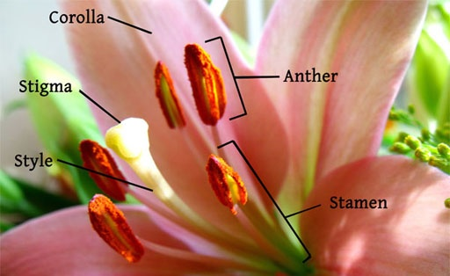
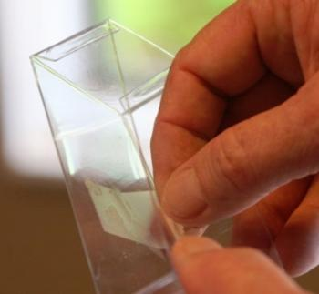
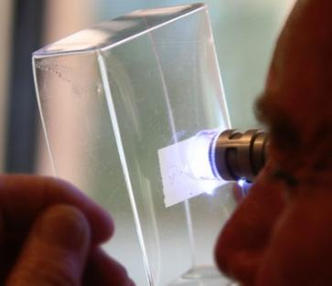
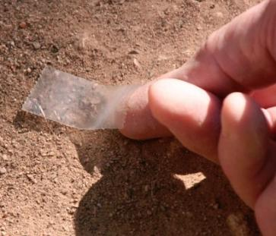
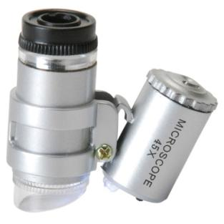
POLLEN: Pollen is one of the common particulates in the air. For people with allergies, pollen is one of the biggest triggers of allergic reactions. Pollen is stored on the anthers, which sit on the ends of stalks called filaments. Collect pollen by touching the anthers with a piece of Scotch tape. Then place the tape on the inside of the acrylic box. Also get a sample of dirt with a piece of tape and apply it to the inside of the acrylic box. Using the mini-microscope, look at the pollen and dirt samples from the other side of the acrylic box.

Slide 20
Air Pollution: Ozone
Ozone (a gaseous air pollutant): In addition to particulates in the air, there are unhealthy gases. Ozone (O₃) is one of them. Ozone is commonly found is sunny regions with lots of traffic (like Phoenix). Ozone can be detected by its ability to react with potassium iodide (KI) in the presence of moisture to make elemental iodine (I₂). Below is the chemical reaction.
2KI + H₂O + O₃ → 2KOH + O₂ + I₂
Potassium iodide + water + ozone → potassium hydroxide + oxygen + iodine
At the same time, moisture in the air causes some of the potassium iodide to break apart into positive potassium ions (K⁺) and negative iodide ions (I⁻). “(aq)” means dissolved in water.
KI + H₂O → K⁺_{(aq)} + I⁻_{(aq)}
The negative iodide ion (I⁻) can combine with the elemental iodine (I₂) to yield a negatively charged triiodide ion (I₃⁻).
25% of corn starch is a polymer of glucose (called amylose), which is shaped like a helix. The triiodide ion (I₃⁻) enters the center of the amylose helix and makes it turn reddish blue.
I⁻ + I₂ → I₃⁻

Slide 21
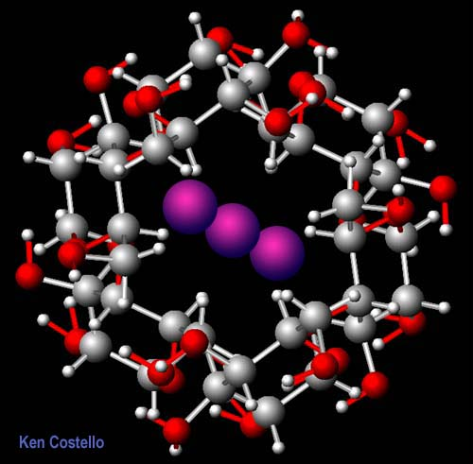
25% of corn starch is a polymer called amylose, which is shaped like a helix. The triiodide ion (I₃⁻) enters the center of the amylose helix and makes it turn reddish blue.

Slide 22
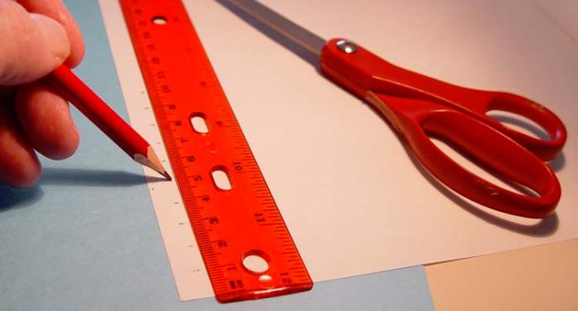
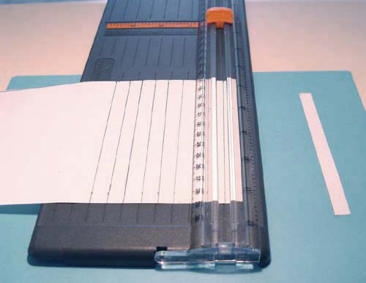
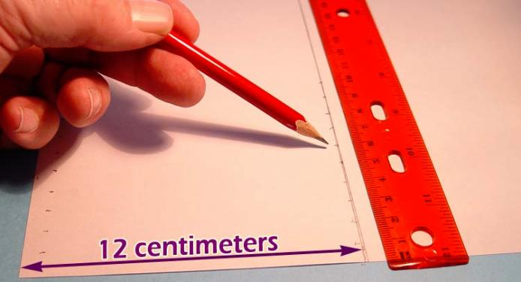
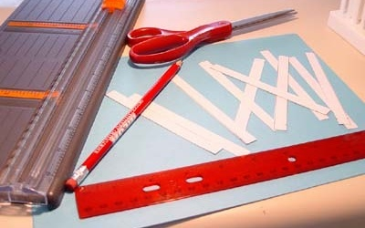
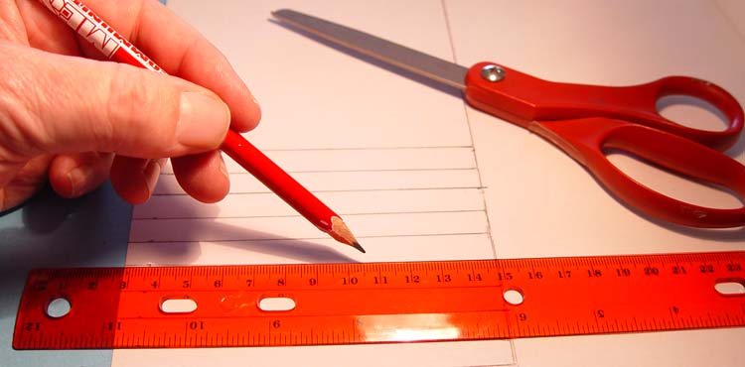
Making ozone test strips: 1) Draw out 10 rectangles that are each 12 centimeters long and 1 centimeter wide. Cut them out using scissors or paper cutter.

Slide 23
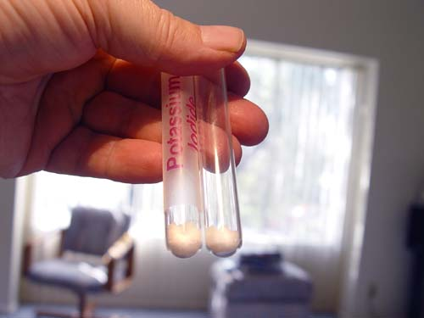
Using the potassium iodide test tube, pour about one half of its contents into a clean empty test tube. Here you see they end up with about the same amount.

Slide 24
Add distilled water to the empty test tube that you had placed one half of the potassium iodide. You can use a disposable pipette to transfer the water or pour the water directly in from the small beaker.

Slide 25
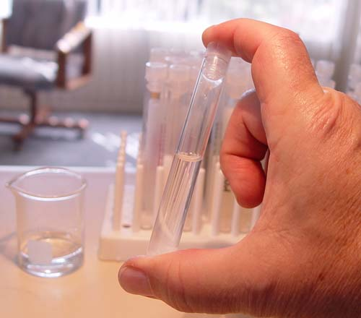
Shake the test tube to dissolve the potassium iodide. It should dissolve fairly easily.

Slide 26
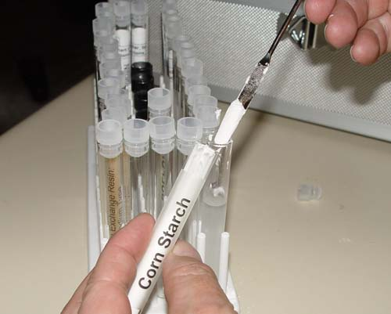
Now use the microspatula to add about 1 gram (two scoops) of cornstarch to the potassium iodide solution.

Slide 27
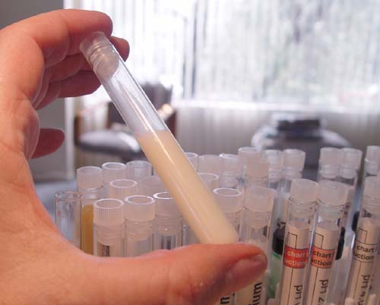
Place the stopper back on the test tube and shake it to mix the cornstarch. The cornstarch will not dissolve but will stay suspended in the solution for several minutes.

Slide 28
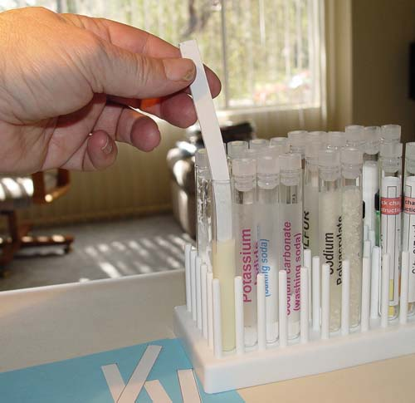
Take cap off of test tube and start dipping your paper strips into the solution. Allow the strip to stay in solution for about five seconds before removing.

Slide 29
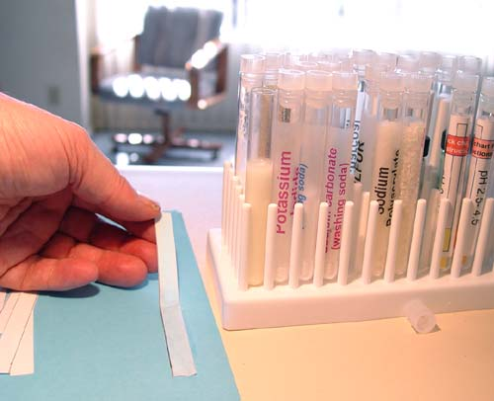
Lay the wet strip on a piece of paper or paper towel. Let it dry.

Slide 30
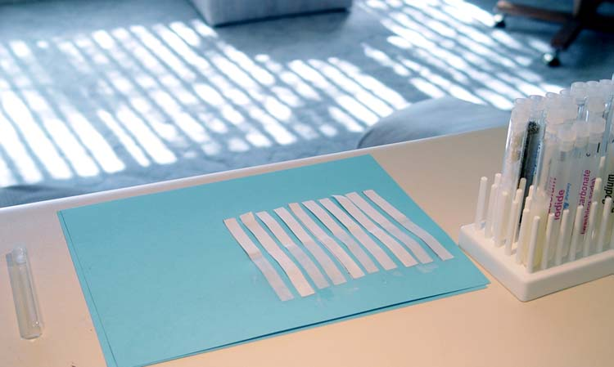
Below you can see that I had dipped 10 strips into the potassium iodide/cornstarch solution. Let them dry, which shouldn't take long, maybe 20 minutes. To preserve them and for carrying them home, place them in a ziploc bag. You only need 5 strips at home. So the other 5 can be shared with lab partner.

